Slide 1
Vibrating Wallpaper
By Tim Shur
Differential Geometry

Slide 2
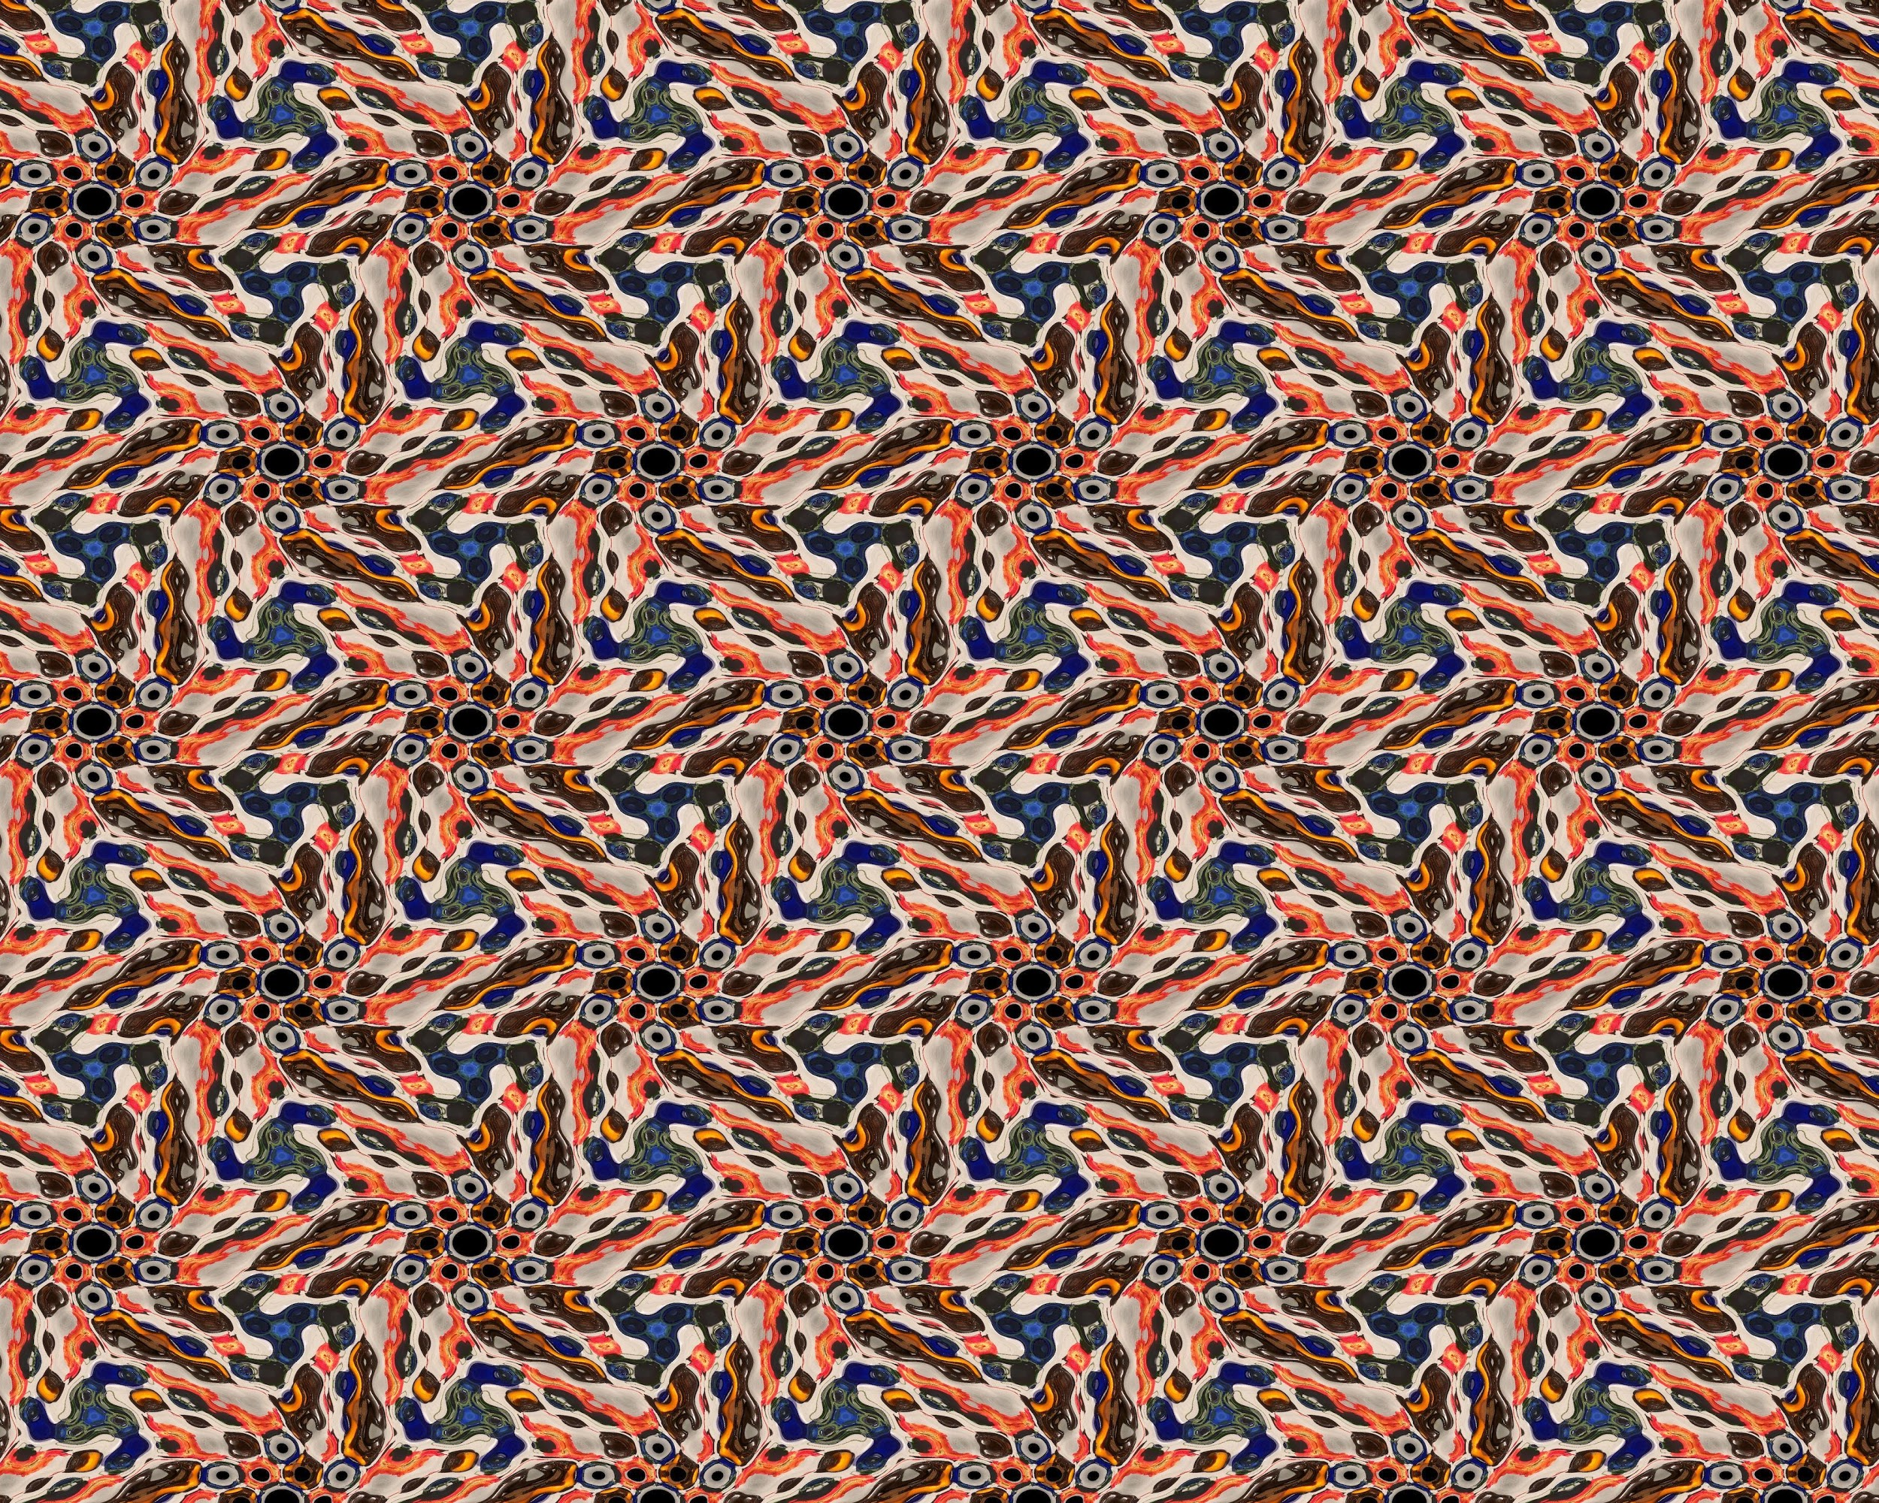
What is Wallpaper?
A pattern with horizontal and vertical translational symmetry
Can also have other symmetry such as rotational symmetry
Can be created with domain coloring with special functions
Quite complex

Slide 3
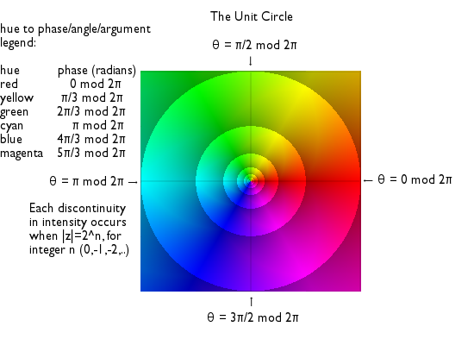
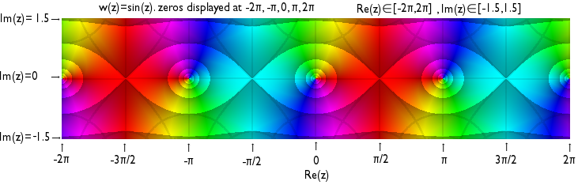
What is Domain Coloring?
color wheel
Im
Method to visualize complex functions, .
Find a complex function to visualize
Get a color wheel image
Use the output of the function for the color
Plot the color at the domain’s coordinates
Re
sin(z)
Im
sin(pi/2 + 0i)
Re

Slide 4
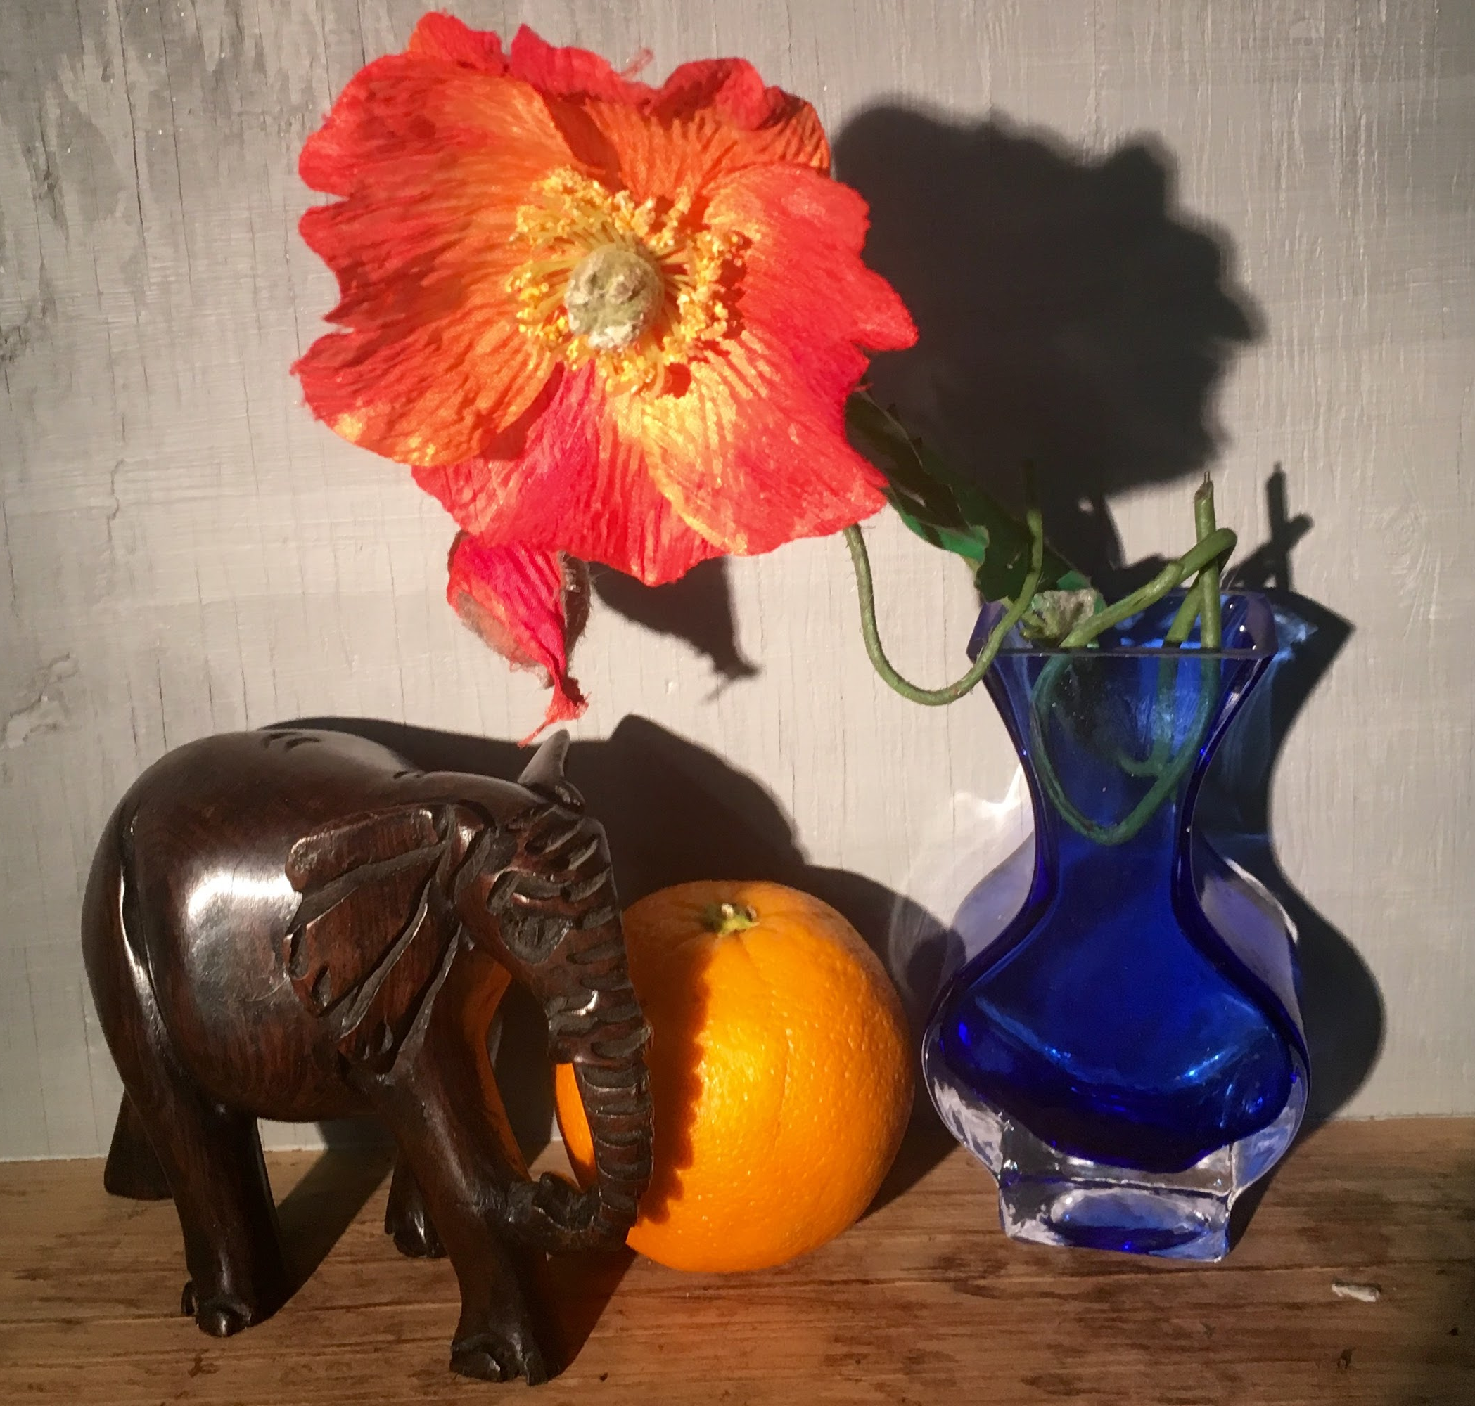
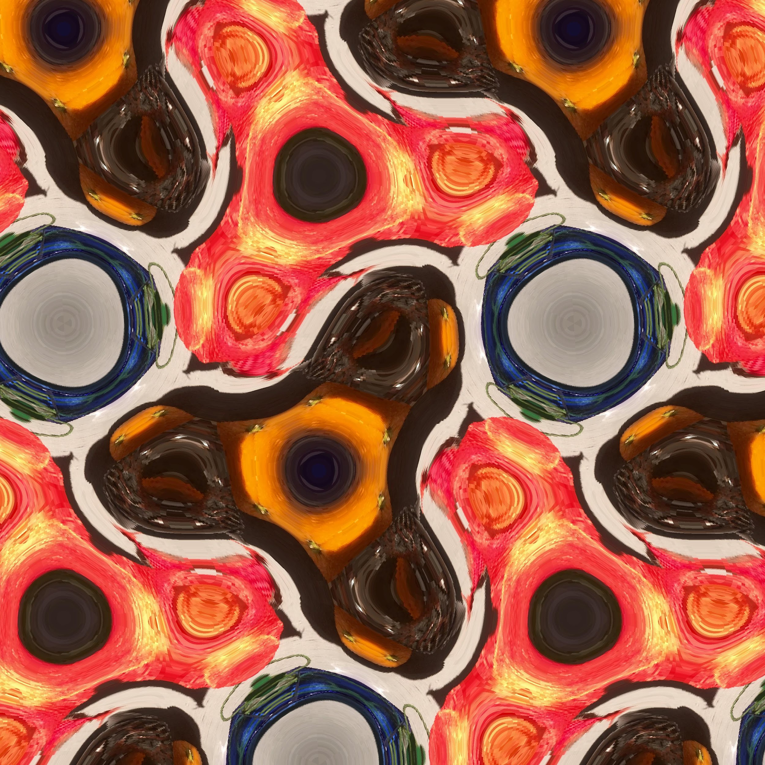
Then How Do We Make Wallpaper?
Do the same thing with a special wallpaper function
We can also use any image (such as a photograph) instead of a color wheel!

Slide 5
What is Vibrating Wallpaper?
We can take wallpaper and move it through time
Our goal is to animate wallpaper in a natural way
First, we develop our method with simple cases

Slide 6
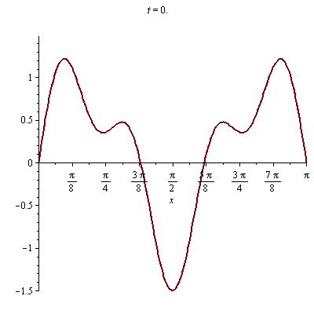
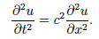
How Can We Animate a String?
Given a string fixed at both ends and an initial position, we simply solve the wave equation!
initial position
wave equation
solution!

Slide 7
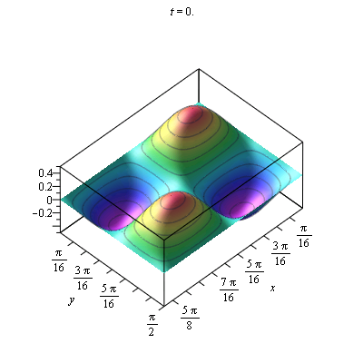
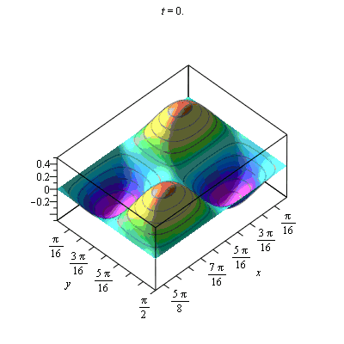
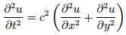
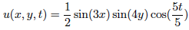
How Can We Animate a Surface?
Given a surface with fixed boundary and initial displacement, we simply solve the wave equation (again).
initial position
wave equation
solution!

Slide 8
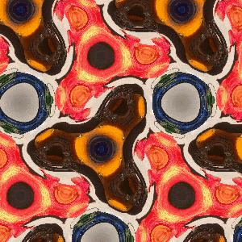
Then How Do We Animate Wallpaper?
The exact same thing with a complex function! Simply find the special solutions to the wave equation.
Solution for complex-valued surfaces:

Slide 9
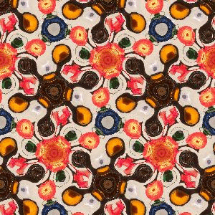
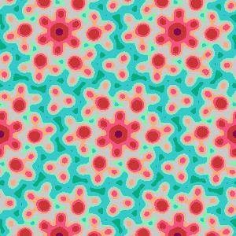
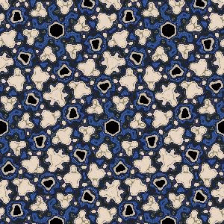
Other Examples & Future Research

Slide 10
Any Questions?
Work Based on Farris’ Creating Symmetry and the open source software by Bowdoin students SymmetryWorks!

